Slide 1
Week 3 Lab
Chapter 3 – Information System

Slide 2
Information System
Q1) Should Information system necessarily mean computer system?
Q2) Discuss an example or circumstance where Information system is aiding to the decision making.
Q3) A clothing brand is planning to conduct its clothing business in the valley. It has planned to open 7 different outlets in various parts of the valley. It’s main products are T-shirt (Round and V neck), Pants(Jeans, cotton), Shirt(winter specific, summer specific) and shoes(leather, converse).Apart from the in-site sales, it is also trying to provide customers with provision to view products online and order with the availability of home delivery(not fully e-commerce based)
From the systems perspective ,describe the decisions to be made in the domain of strategic planning, managerial and operational control? What information would be needed to make such decisions?

Slide 3
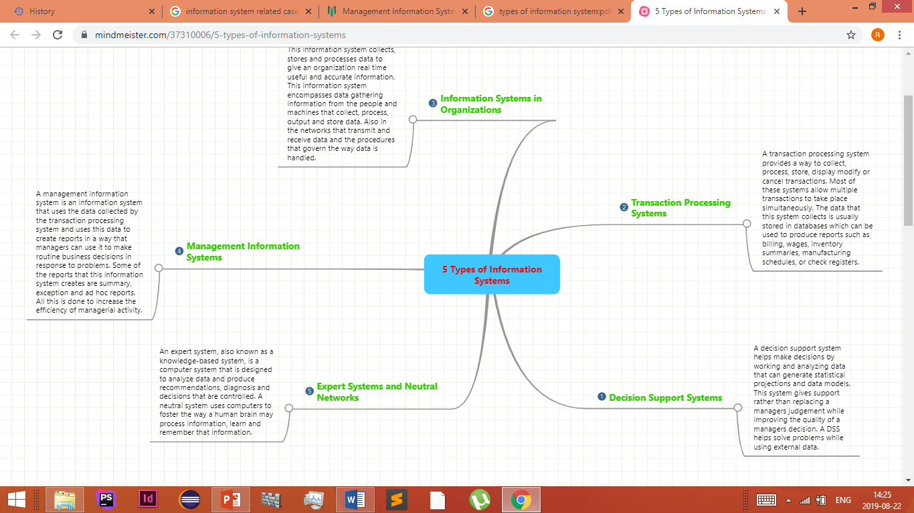
Information System

